Slide 1
THE ORGANIZATIONAL DIRECTION OF TELKOM: STRYCTURE, DESIGN, DIRRENTIATION STRATEGY AND CORPORATE CULTURE
Presentation by (Insert your Name Here)

Slide 2
Organizational Structure
Organizational structure simply refers to the hierarchical system of an organization.
Structure of an organization involves things such as the roles and responsibilities of various people
It also includes things such as the chain of command in an organization
Organizational structure can be presented diagrammatically as a hierarchy showing the chain of command
Notes:
Organizational structure describes the rules, roles and responsibilities within an organization, things we more commonly describe as the organization's hierarchy. The hierarchy of command in an organization is a depiction of the structure of that organization (Thompson, 2019). This shows the roles of each employee sand to whom each employee reports/. This is why it can be represented diagrammatically as a chart showing the chain of command.

Slide 3
Organizational structure continued
The structure of the organization determines the following things
who reports to who
how jobs are performed or done within and organization
What people do in n organization and their job descriptions.
How each and every job fits in the overall system
Who makes decisions, and
Who each employee reports to.

Slide 4
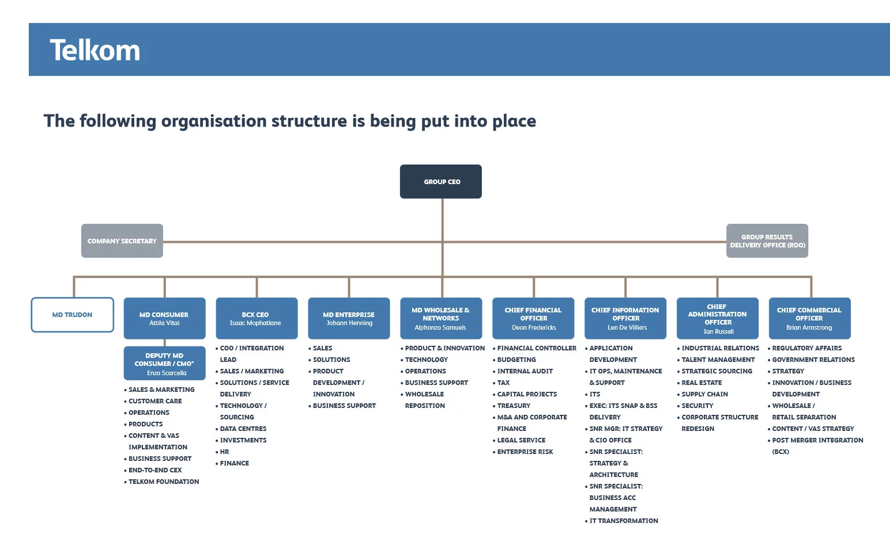
The organizational Structure of Telkom
Notes:
In a nutshell, the structure of Telkom is in such a way that at the top, there is the Chief executive officer. Under him there are managing directors and chief information officer, chief financial officer, chief administration officer as well as chief commercial officer.

Slide 5
Organizational Design
Organizational design refers to the methodology and process utilized by an organization to identify any dysfunctional elements and procedures.
Organizational design is related to organizational structure but it is different from organizational structure.
Organizational design is a continuous diagnostic process and helps and organization to rectify any malfunctional elements in its operations.
Notes:
Organizational design’s purpose is to identify the dysfunctional elements of a company's procedures, systems, workflow or even its organizational structure with the aim of making positive changes to help the company meet its objectives and current business goals. Organizational design takes a holistic look at the company with a view to identifying inefficient workflows, such as communication breakdowns and steps that don't add value (Thompson, 2019). Since organizational design keeps changing, the future of work is also bound to change in the same way as the designs of organizations continue to evolve (Mueller, 2014)

Slide 6
The organizational Design of Telkom
Telkom applies one of the most effective organizational designs.
Functions and procedures are verified at all levels starting from the managerial level, to the supervisory level and to the level of performance of job tasks.
Any flaws detected at any level are communicated to the highest level of the chain of command for immediate action.
This helps Telkom to eliminate errors at the early stages before it escalates to the consumers of the Telkom products.
Notes:
The diagnostic process at Telkom takes a holistic approach. However, the key areas that are examined and diagnosed for errors and lack of addition of values include the way employees perform their duties in various departments. The stages of production of airtime and scratch cards is also examined to ensure efficiency in the process. Misprints and defective denotation of the values of the scratch cards is done by computer and verified by human effort. However, diagnosis is done to ensure no repetition of work in the organization. All these activities encompass organizational design of the Telkom.

Slide 7
Organization’s Differentiation and Growth Strategy
Telkom’s differentiation strategy involves a keen and heavy investment is E@synet internet products and Home internet packages.
Telkom is shifting away from developing products based on costs to emphasizing reliable and high speed internet for its customers.
Home internet has ben for long left unexploited by competitors and therefore concentrating on this product provides the company with growth and expansion opportunities.
With the already existing infrastructure used by Posta corporation, the company can reach many towns at a reduced cost compared to developing new products.
Notes:
A differentiation strategy is an organizational shift away from marketing and product development based on cost to emphasizing the high quality of your small business' products and services.

Slide 8
Strategic Options and Management Approach Related to Organizational Goals and Strategies
Strategic options for Telkom include expansion of the network from major towns to remote areas to provide internet access.
Another option is diversifying services to include business and corporate internet solutions.
Providing internet service to both government and private schools and institutions of higher learning
These options requires a management approach geared towards obtaining a higher bandwidth from the Communication Authority and training employees.
Notes:
There are numerous opportunities and options that go hand in hand with the strategic goals of Telcom. Since the provision of home internet has ben neglected by competitors because of the cost, the company can use the already established infrastructure used by Posta Corporation to provide internet access to all tows and their neighborhoods and also expand its services to schools and universities which present a greater opportunity for expansion. However, this will require careful planning and training of employees as well as acquiring a higher ad stronger bandwidth from the Communications Authority.

Slide 9
Corporate Culture
Corporate culture is simply the way of doing things that defines the behaviour of the management and of an organization towards motivation of employees and enhancement of efficiency.
Corporate culture develops organically
It springs from the interaction of the management and employees of an organization
It has more to do with the non business activities or transactions between management and employees of an organization.
Notes:
Corporate culture refers to the beliefs and behaviors that determine how a company's employees and management interact and handle outside business transactions. Often, corporate culture is implied, not expressly defined, and develops organically over time from the cumulative traits of the people the company hires. Things such as what the organization does to keep employees motivated, what an organization does to ensure good interaction between managers and junior employees and what an organization does to ensure cordial relationship between management and employees all encompass an organization culture.

Slide 10
Methods used to influence employee satisfaction and retention (Telkom)
Organizations use various methods to bring about employee satisfaction. For the case of My organization, Telkom, the methods used to ensure employee satisfaction and retention include
Offering promotion opportunities through internal recruitment.
Offering on-job training to enhance employee efficiency in completing job tasks.
Offering paid sick and family patient leaves to the employees.
Taking to consideration the opinions of the employees before implementing changes in operations.
Involving employees in the managerial decision making process.
Notes:
One of the best ways of retaining employees and ensuring their satisfaction is involving them in decisions that affect their work. Incentives such as paid sick leaves also help employees to be happy in their work places and reduce the likelihood of employees wanting to leave the organization (Terera & Ngirande, 2014). Furthermore, listening to employees on matters that affect their work reduces stress among them and helps to enhance their job satisfaction.

Slide 11
Conclusion
Organizational structure refers to what we call the hierarchical organization of an organization which includes roles and responsibilities and determines things such as the chain of command.
Organizational strategy is a a process and is also methodology used to diagnose organization procedures and operations for defective elements with the aim of making positive changes.
Telkom's major strategic options lie in the provision of home internet and utilization of already existing infrastructure
Employee satisfaction and retention is influenced by things such as incentives and inclusion of employees’ opinions in the decision making process (Terera & Ngirande, 2014).

Slide 12
References
Mueller, J. R. (2014). Alternative organizational design and its impact on the future of work. Journal of Strategic Innovation and Sustainability, 9(1), 48-58. Retrieved from https://search-proquest-com.libraryresources.columbiasouthern.edu/docview/1535386881?accountid=33337
Terera, S. R., & Ngirande, H. (2014). The impact of rewards on job satisfaction and employee retention. Mediterranean Journal of Social Sciences, 5(1), 481.
Thompson, J. (2019). Difference Between Organizational Structure & Design. Small Business - Chron.com. Retrieved from http://smallbusiness.chron.com/difference-between-organizational-structure-design-3839.html

